Slide 1


Retail Sales Performance & Profitability Dashboard
Presented by: YASHWANT Manhas

Slide 2


Project Objective
Project Objective
The objective of this project was to:
• Analyze overall sales performance • Identify profitable and loss-making products • Analyze regional performance • Identify trends over time

Slide 3

Tools and Technologies Used
• Power BI • Superstore Sales Dataset
Skills Applied:
• Data Visualization • Data Analysis • Dashboard Design

Slide 4
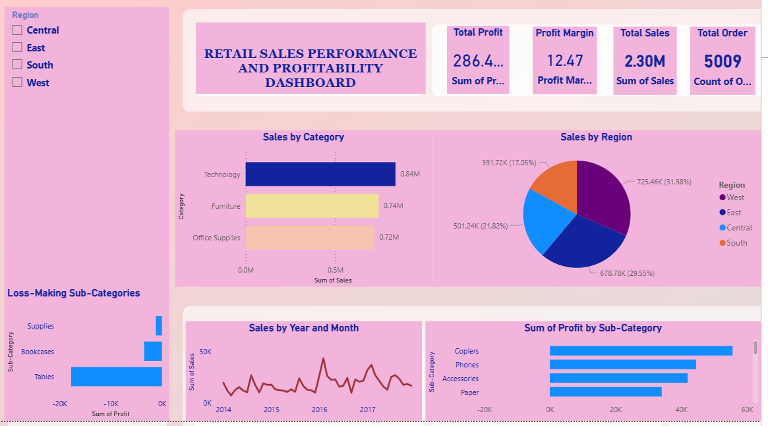
DASHBOARD OVERVIEW

Slide 5




Key Insights
Business Value
• Technology category has highest sales
• West region has highest sales performance
• Sales show fluctuation over months
• Some sub-categories generate lower profit
This dashboard helps business to:
• Improve profit
• Identify best products
• Improve weak areas
• Make data-driven decisions

Slide 6

OUTCOMES
ASSUMPTIONS
• Identified best-performing category: Technology
• Identified best-performing region: West
• Found monthly sales trends and seasonal patterns
• Identified sub-categories with low profit
• Dataset contains accurate and complete sales records • Sales and Profit columns represent actual business performance • No major missing or incorrect values affecting analysis • Dataset represents overall retail business performance
6

Slide 7



CONCLUSION
• Technology category drives highest revenue
• Some products need improvement due to low profit
• Regional analysis helps focus on strong and weak areas
• Dashboard helps business make data-driven decisions

Slide 8
Thank you
YASHMANHASofficial@Gmail.com

